Slide 1
Rule Based Auto-Planning
Template driven in Monaco TPS
Xiaotian Huang

Slide 2
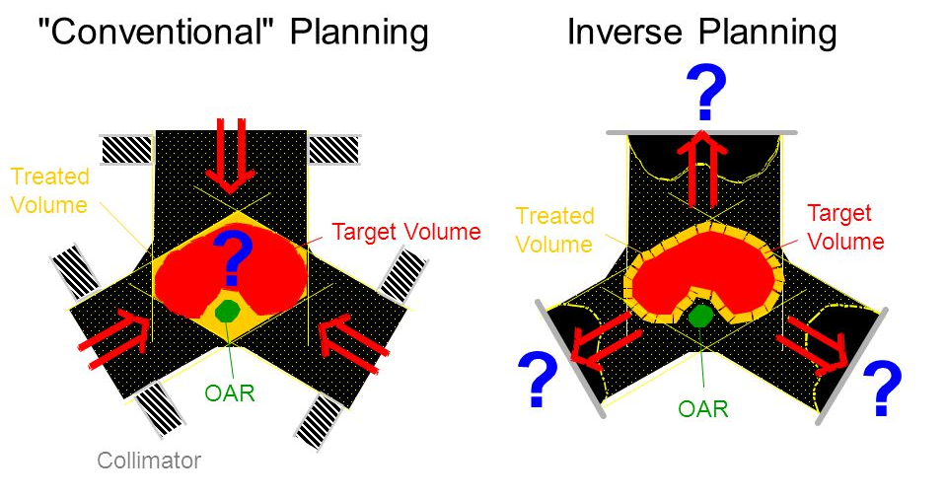
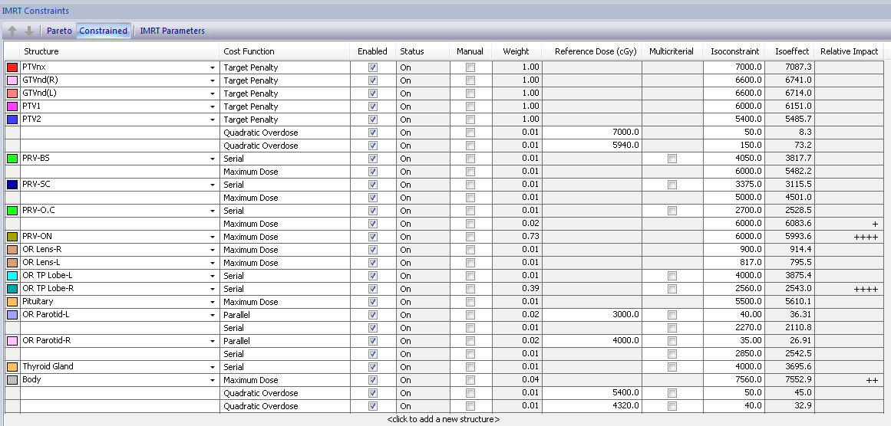
Inverse Treatment Planning
IMRT(Intensity Modulated Radiation Therapy)
IMRT parameters: weights, orientation, isoconstraints, power law, shrink margins…..
Trial-and-error treatment planning process
Time-cost & Labor-intensive
Monaco Bio-optimization parameters

Slide 3
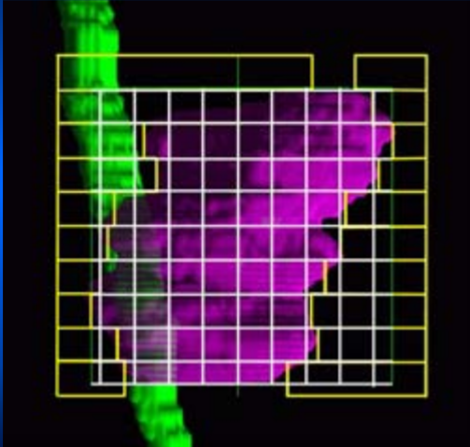
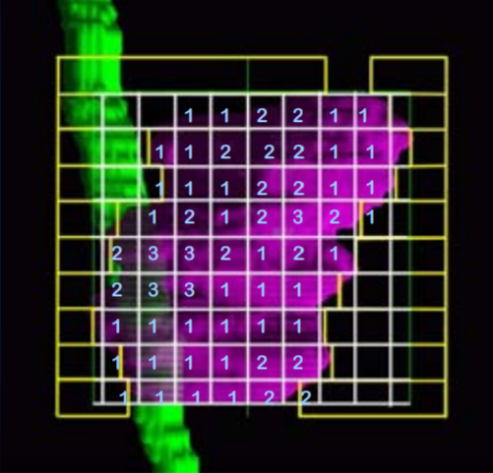
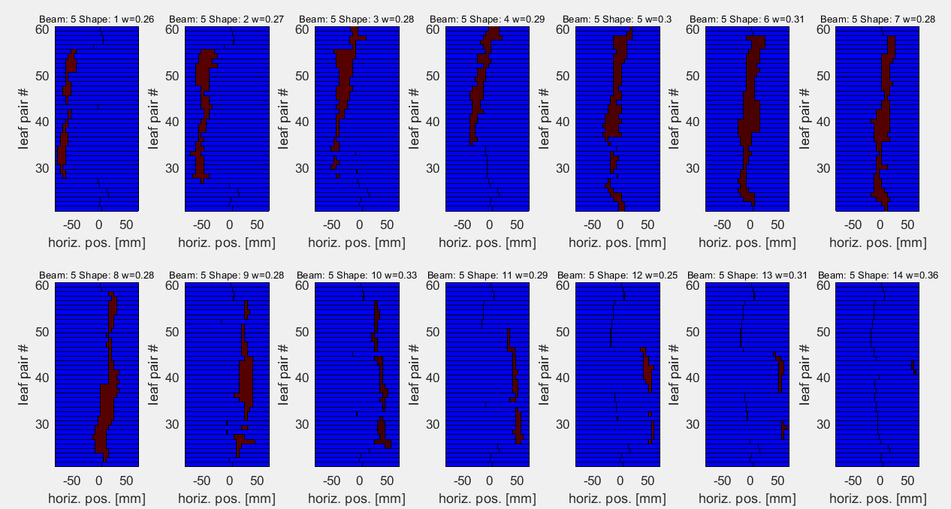
Monaco TPS
Beamlet-based Inverse IMRT plans
Two-Stage approach to treatment planning:
1. Fluence map optimization with PB algorithm - Delivery constraints ignored.
2. Segments Optimization with MC algorithm – Accounts for delivery constraints
BEV divided into a grid of beamlets
Optimized Fluence Map
Segments weight & shape optimization (Leaf Sequencing)

Slide 4
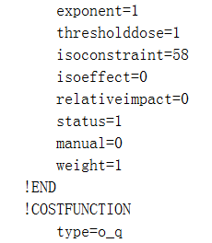
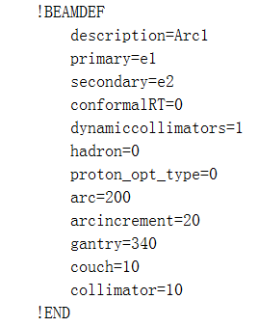
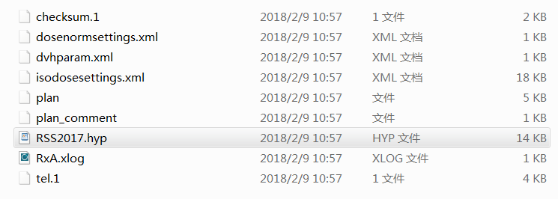
Monaco TPS
Template Role
Store optimization parameters (angles, weights, structures…) of a plan
Reduce repetitive and intensive planning of similar patient cases
Easy to transfer and build up template data base for certain institutions
IMRT parameters in .hyp file

Slide 5
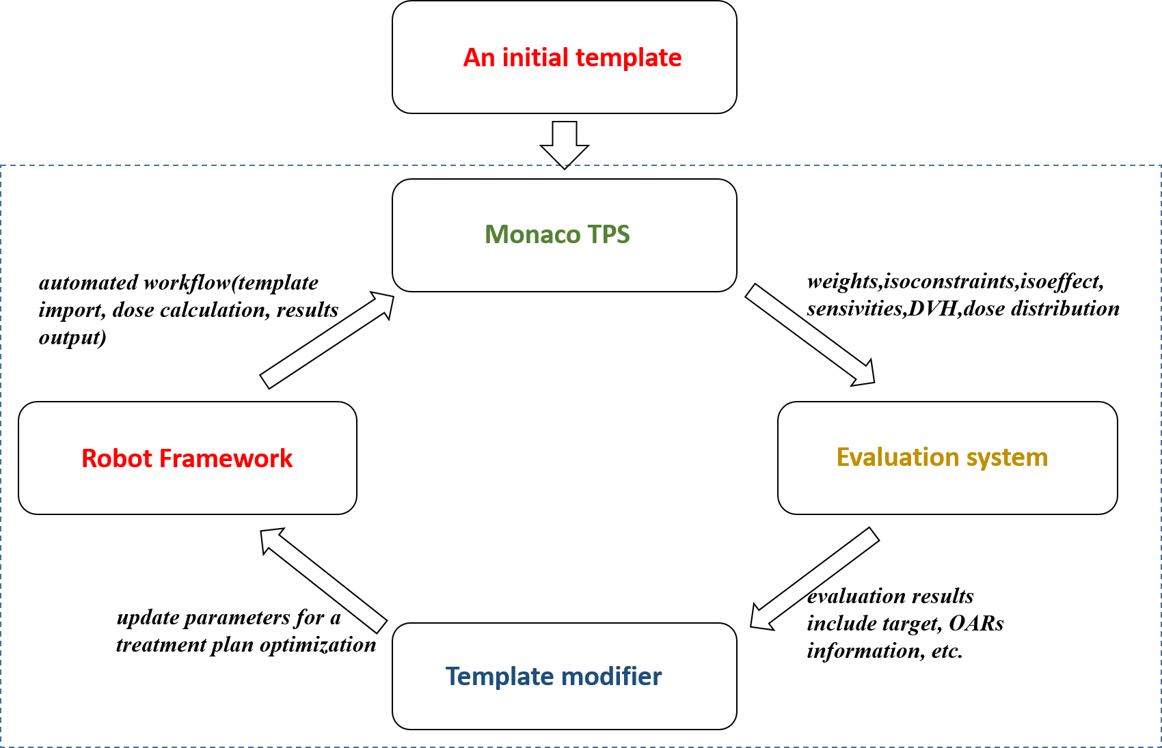
Our Idea for auto-planning
Monaco TPS
A rule-based program modify IMRT parameters in template (.hyp)
Template as an interfacing “media” between program and Monaco
Only fluence map optimization
DVH statistics as evaluation criteria
Robot framework as auto-tool to replace mouse-click
Only VMAT delivery
Auto-planning Structure

Slide 6
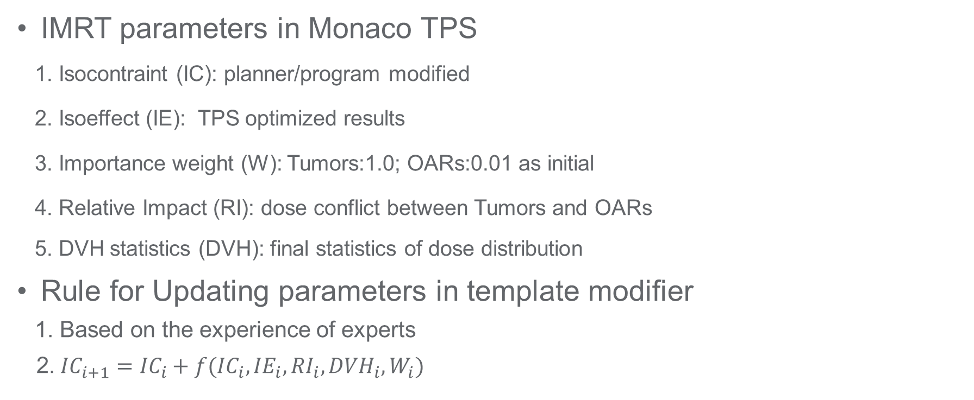
Auto-Planning
Template Driven & Rule Based
IMRT parameters in Monaco TPS
1. Isocontraint (IC): planner/program modified
2. Isoeffect (IE): TPS optimized results
3. Importance weight (W): Tumors:1.0; OARs:0.01 as initial
4. Relative Impact (RI): dose conflict between Tumors and OARs
5. DVH statistics (DVH): final statistics of dose distribution
Rule for Updating parameters in template modifier
1. Based on the experience of experts
2. ${IC}_{i+1}={IC}_{i}+f({IC}_{i}, {IE}_{i},{RI}_{i},{DVH}_{i},W_{i})$

Slide 7
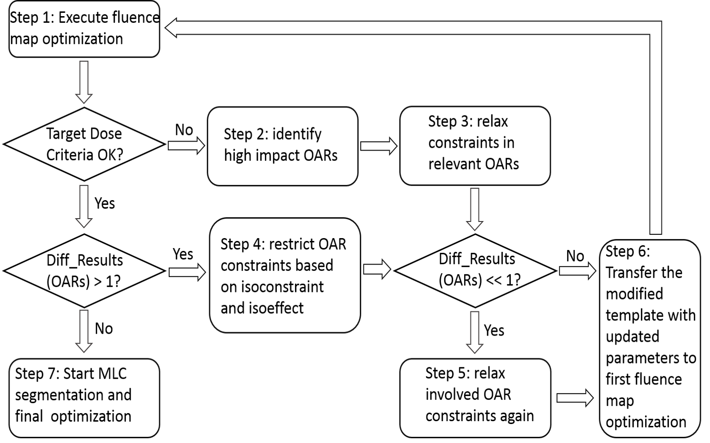
Auto-Planning
Template Driven & Rule Based
Rule for Update Template

Slide 8
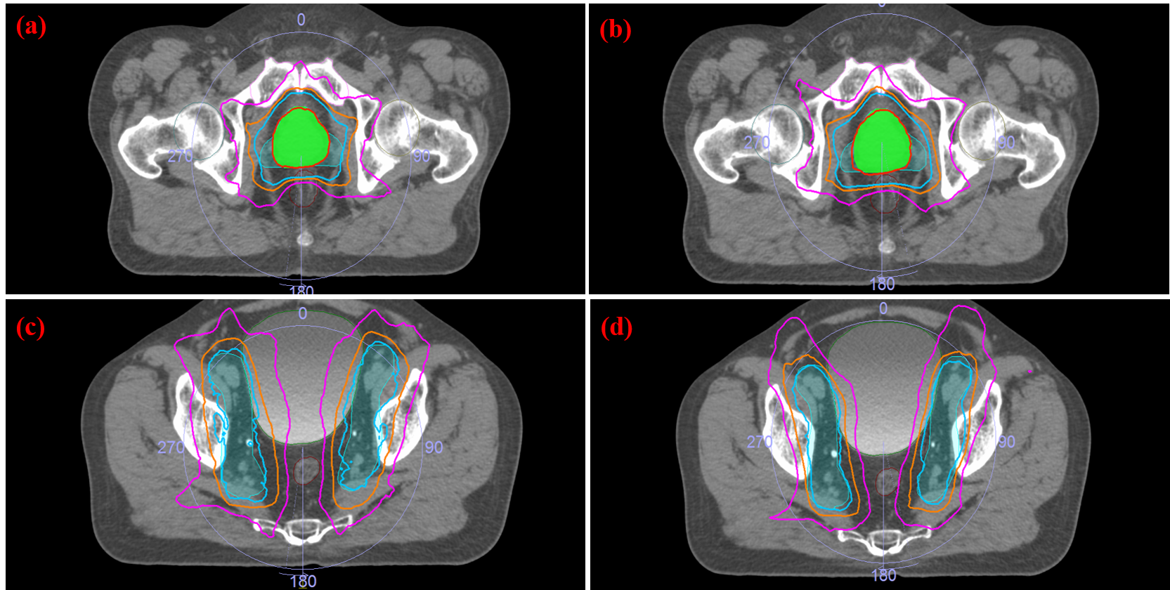
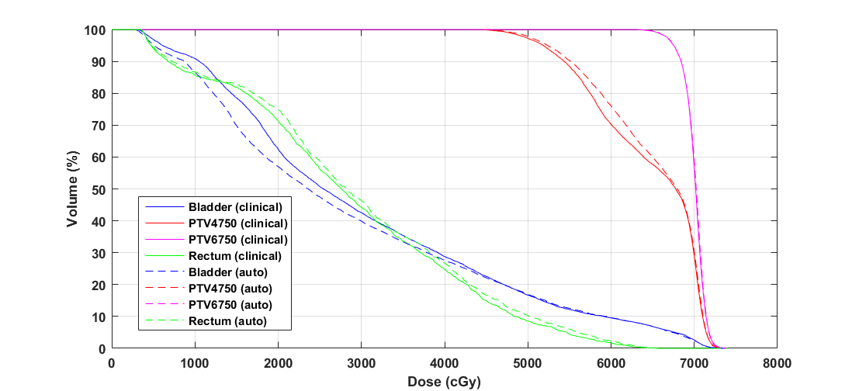
Auto-Planning
Results
Dose distribution & DVH Comparison of auto (b, d) and clinical (a, c) prostate plans

Slide 9
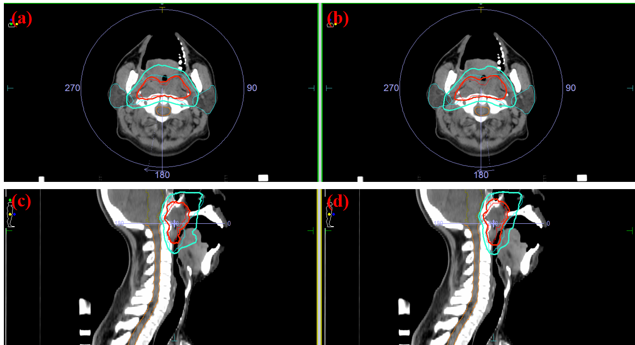
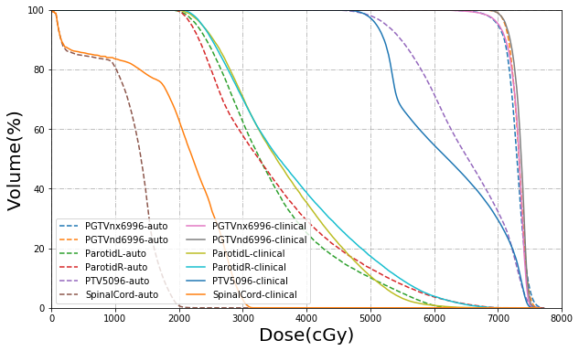
Auto-Planning
Results
Dose distribution & DVH Comparison of auto (b, d) and clinical (a, c) Head&Neck plans

Slide 10
Details
How to initialize the whole workflow?
How to evaluate the plan quality?
What if the prescription request couldn’t be met?
What is the efficiency of auto-planning?

Slide 11
Details
How to initialize the whole workflow?
For prostate and HN cases, rule based on prior experience
Automatically generate the .hyp file
OAR’s cost functions should be relatively relaxed
Initial DVH criteria (.xml) should be generated automatically with .py

Slide 12
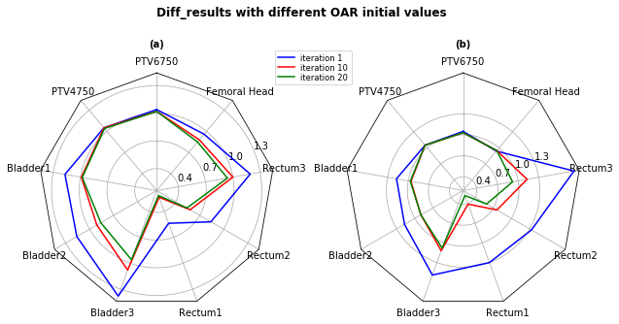
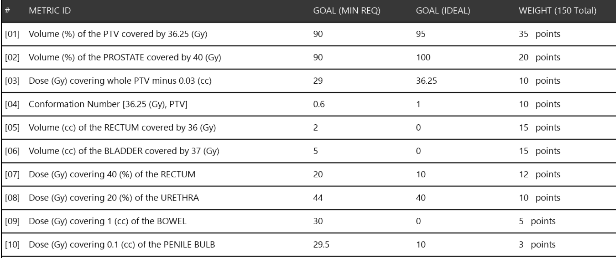
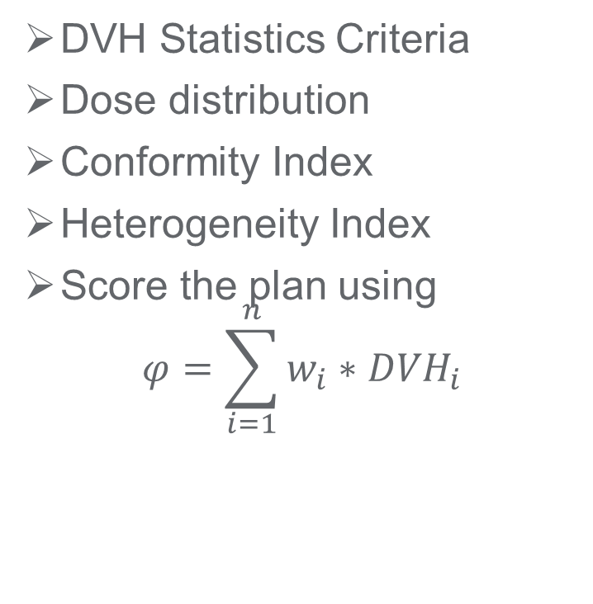
Details
How to evaluate the plan quality?
DVH Statistics Criteria
Dose distribution
Conformity Index
Heterogeneity Index
Score the plan using
$$φ=\sum_{i=1}^{n}{w_{i}∗{DVH}_{i}}$$

Slide 13
Details
What if the prescription request couldn’t be met?
Prescription request is experience based
The patient anatomy differs
Solution:
PlanIQ or DL model predict the dose distribution as reference
Change some criteria request in prescription

Slide 14
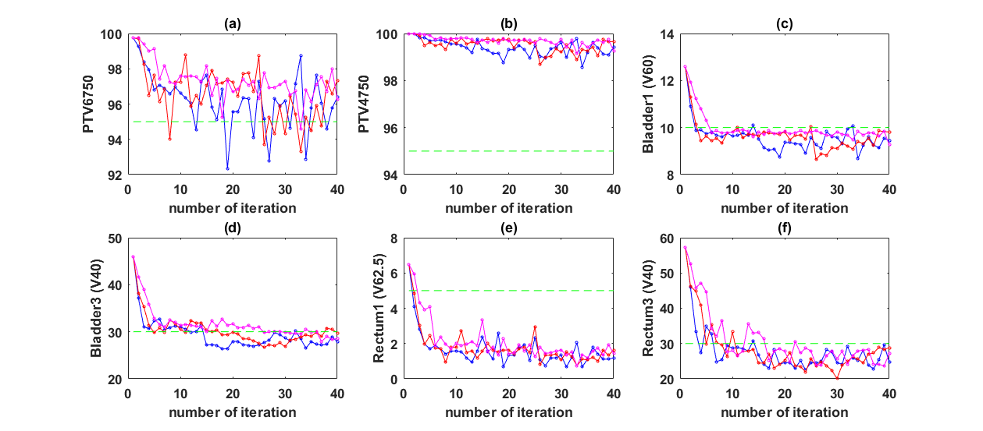
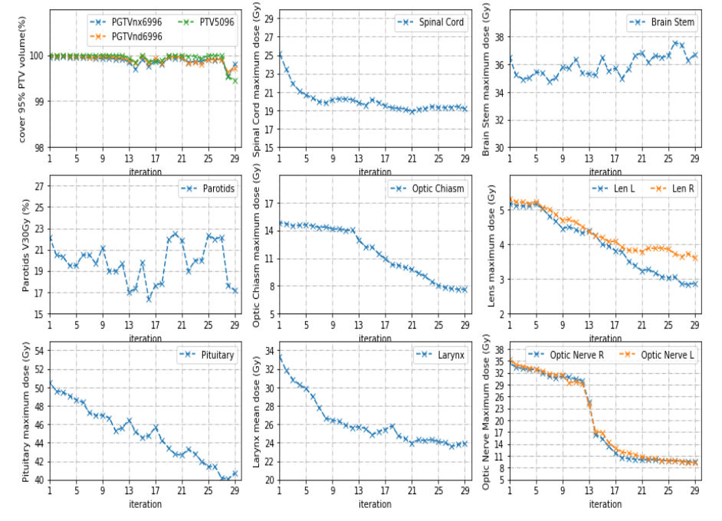
Details
What is the efficiency of auto-planning?
Prostate: ~15 iterations (30s/iter)
Head&Neck: ~25 iterations (50s/iter)
Prostate
Head&Neck

Slide 15
Future Work
Robustness & Intelligence
Reinforcement Learning
Planning similar to playing game
Q-learning approaches
A3C approach
Improve interfacing efficiency between TPS and program
Need more workstations for parallel computation
Warm-Start for optimization
Improve TPS optimization efficiency
Avoid inner optimization iteration limits
Better performance
Recompile Monaco TPS
Comparison to no-warm start version
Orientation Optimization
Orientation optimization is vital in IMRT
Lung V5 needs a strict selection of beam orientations
To incorporate evolution algorithm into selection of optimal orientation

Slide 16
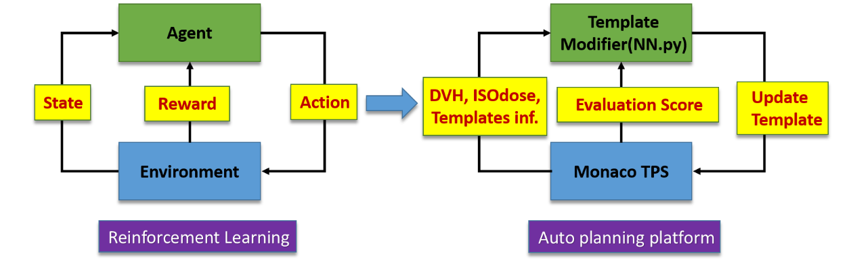
Reinforcement Learning
Q-Learning applied in planning
Trial-and-Error learning process
Q(State, Action) for estimation
Communication between program and TPS

Slide 17
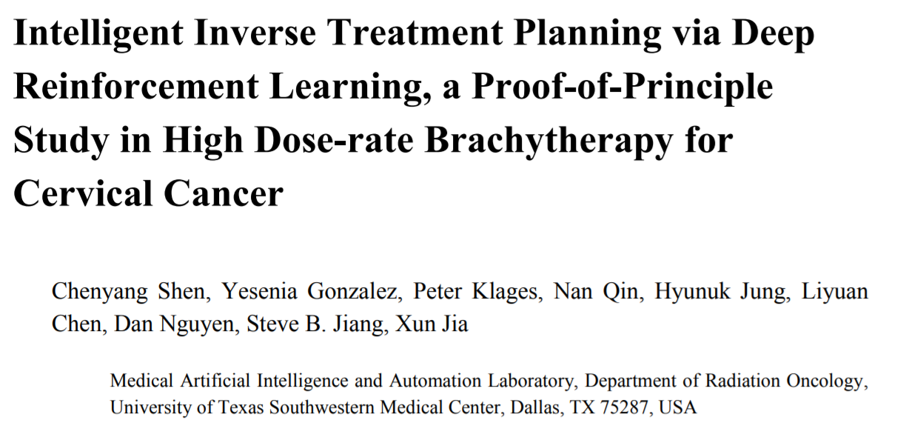
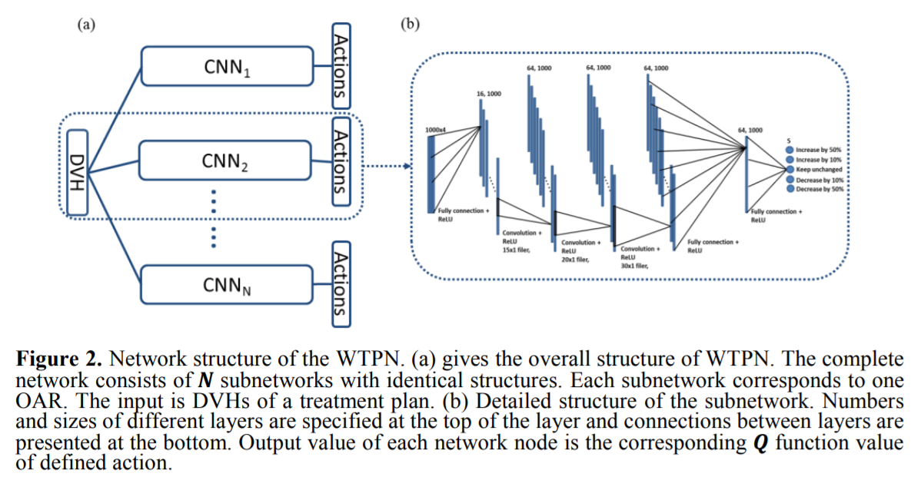
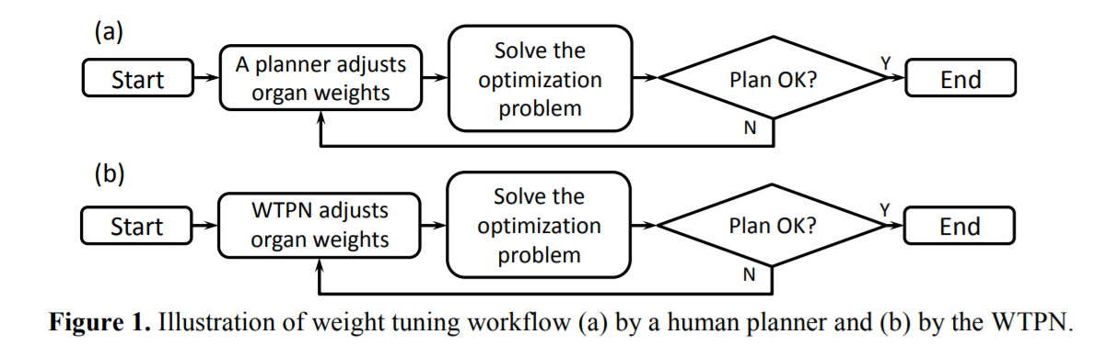
Reinforcement Learning
High-dose-rate brachytherapy
https://arxiv.org/abs/1811.10102

Slide 18
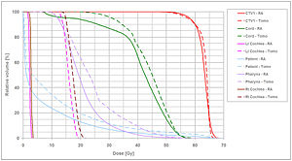
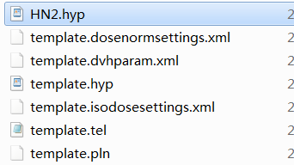
Drawbacks of Current Structure:
Unstable: 1) small bugs destroy whole loop
2) evaluation sys. rough
Inflexible: 1) ossified relationship
2) rely on the initial template
3) lack generalization
Reinforcement Learning
Current Structure
DVH results
Isoconstraints
Isoeffects
Sensitivity
Weights
Template Modifier(.py)
Updated Isoconstraints in template
Future Structure
NN as Agent
Isoconstraints1(RectumSerial) + 2Gy
…
Isoconstraints2(RectumParallel) – 7%
Isoconstraints2(BladderSerial) – 5Gy
Isoconstraints2(BladderParallel) + 4%
Template Modifier(.py)
…
Advantages of Future Structure:
Considering the mapping between input parameters and output parameters are opaque, Neural Network act as a more general Agent to update the template.
It can continuously learn good methods and avoid bad methods with Reward function
It actually learn a best strategy of treatment planning through large searching methods

Slide 19
Reinforcement Learning
Q-Learning applied in planning
Parallel TPS for data collection
Improve training efficiency of neural network
Action1
Action2
Action3
Action4
Action5
Action6
TPS1
TPS2
TPS3
TPS4
TPS5
TPS6
Neural
Network
…
Reward2
Reward3
Reward4
Reward5
Reward1
Reward6
Batch(Action, Reward, State)

Slide 20
2019.1.7
Solved:
1. Monaco Auto platform (warm start for FO):
One iteration time costs average 10-15s (WS) vs. 30s-1min(no-WS).
Workstation(10.134.195.78) shared for Biomind.(Win10 still setting)
2. Patient Data (100 HN TOMO data with CT,STRUCT,PLANDOSE):
DICOM issues (fail to load into Monaco) from Biomind solved
HN data lack auto-segmentation for (optic chiasm, esophagus and pituitary )
Unsolved:
1. Evaluation of treatment plan (REWARD):
Score of a plan via PlanIQ
Dose prediction for ideal dose distribution(Ideal DVH Shape could be as an input?)
2. Action Space(continuous):
HN average 30 cost functions (each CFs have 3-4 parameters)
Epsilon Greedy (ε possibility for rule-searching, 1- ε possibility for max cumulative Reward searching)
Target first + OARs second

Slide 21
2019.1.7
Next work
1. Code a draft RL structure connected with MT.py (interfacing program)
Evelyn, Henry would build and test the platform.
2. A parallel structure for data collection (10 Workstations)
A3C may allow us to training several models parallel in multi-environments.
Setting Monaco TPS in 10 different workstations.
3. Orientation optimization for a plan.
Angles could be dynamically modified in IMRT template.
Genetic Algorithm for optimization
4. From auto-contouring to auto-planning
Name issues could be avoided

